Slide 1
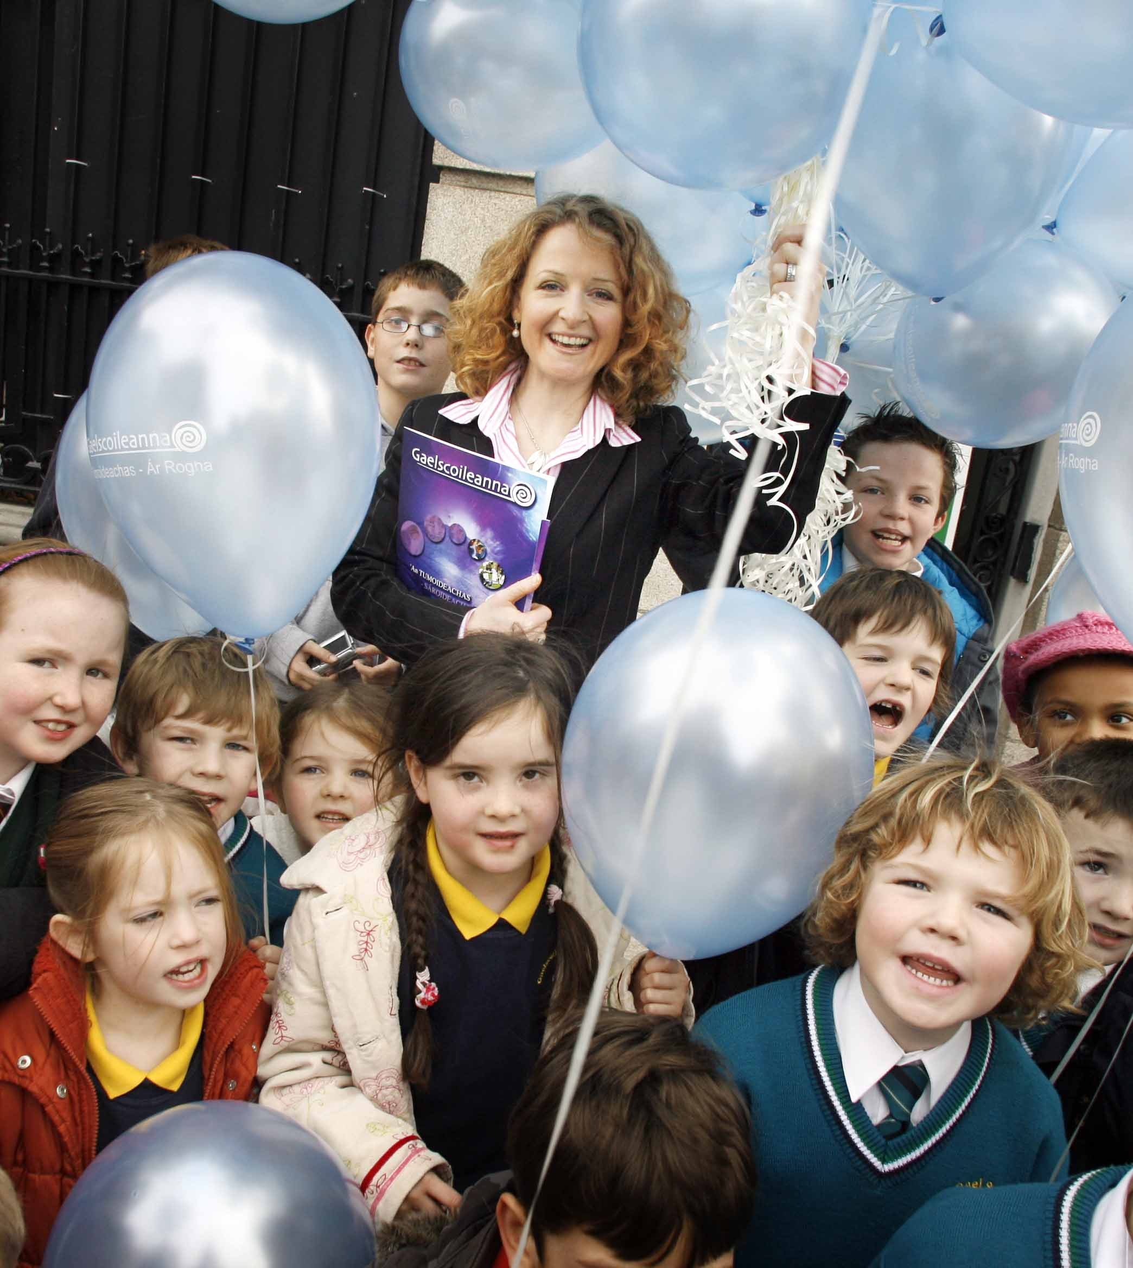
Tumoideachas Immersion Education

Slide 2
Cad é? What is it?
Níl Béarla ag an múinteoir!
Entire curriculum through Irish
Delaying the teaching of English
Reading first in Irish
Immersion vs. submersion
Notes:
11 subjects on the primary curriculum:
Irish, Maths, PE, Visual Arts, Music, Drama, History, Geography, Science, Social, Personal & Health and… English!
All Irish and international research shows that the sooner the child becomes bilingual, the greater the cognitive benefits.
No guidelines from the DES re immersion period, international best practice is for a full 2 years; this allows children to develop their phonics and reading skills before the introduction of a second reading language.
DES draft guidelines for Gaeltacht schools (to be published shortly) suggesting full immersion for 2 years.
Spongebob and Patrick: immersion model supports children’s language acquisition through total absorption and involvement, it is not a “sink-or-swim” approach

Slide 3
Cúiseanna imní… Concerns…
What about their English?
Myths:
The greater one’s competence in a second language, the lesser one’s ability in the first language
Children for whom English is not their home language will not gain fluency in English
Research evidence:
Increased metalinguistic awareness
Higher achievement in both English and maths than their peers in English-medium schools
Notes:
Balloon theory: Being good at maths does not mean you won’t be able to play piano!
Better understanding of the foundations of language – grammar, word formation, sentence order, all transferable skills that help to learn other languages
Languages share the same cognitive process; concepts and skills acquired in one are transferred to the other and are processed in either language since both are interactive
English reading is behind that of their peers for a short period at the beginning, they soon catch up (and then overtake them)

Slide 4
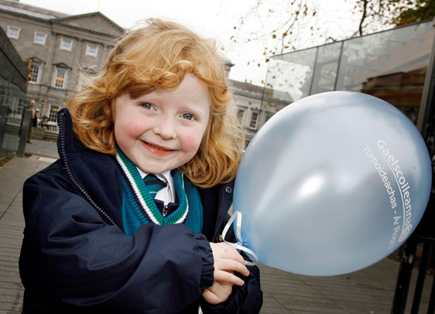
Cúiseanna imní… Concerns…
Won’t they be confused?
Myths:
Children won’t understand the teacher
The ability to speak two languages restricts a person’s ability to think effectively
Research evidence:
Teachers are amazing!
Greater cognitive flexibility or divergent thinking
Increased attentional control
Enhanced executive control
Delays the onset of Alzheimer's by 4 years
Notes:
More creative thinkers; the ability to provide a range of valid solutions to a problem
Better at paying attention, focusing on and completing tasks, listening and communicating; better memory skills
Better at responding to situations and making reasonable decisions; more secure in their decision-making

Slide 5
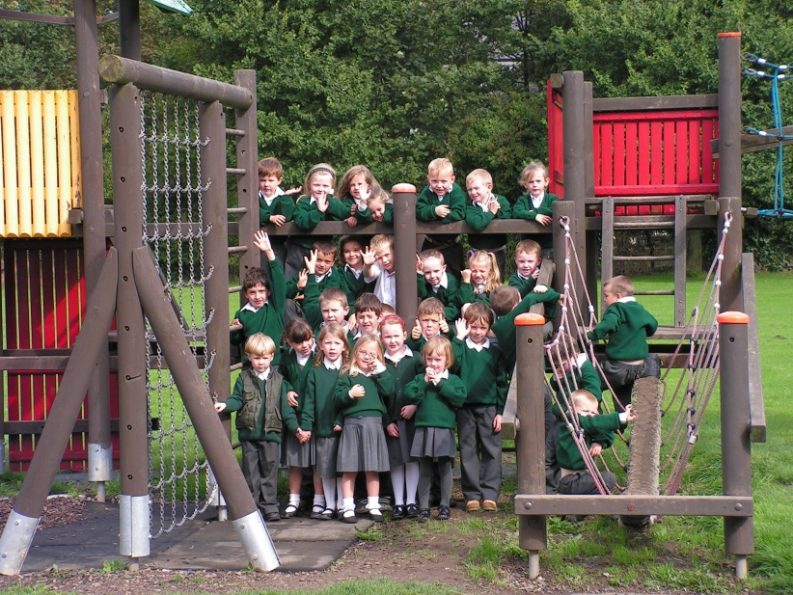
Cúiseanna imní… Concerns…
Will it be too academic?
Myth:
Not suitable for children with special educational needs
Research and Practice:
The same supports are made available to children in Irish-medium schools
Children with SEN enjoy the same benefits of bilingual education
Bilingual education ‘does no harm and clearly does contribute to social, emotional and interpersonal growth’ - NCSE Report, 2011
Notes:
Schools catering for children with physical and intellectual disabilities; sight and hearing difficulties, Autism spectrum disorders, dyslexia, etc.
Irish-medium schools now being granted special units to cater for children with additional needs
ESRI – broader curriculum

Slide 6
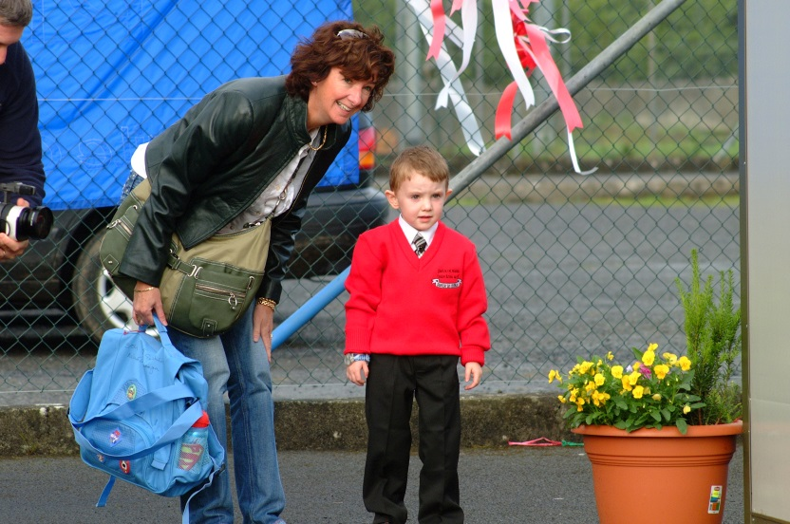
Cúiseanna imní… Concerns…
Will I be able to help?
Myth:
You need fluent Irish as a parent
Research and Practice:
95% of parents whose children attend Irish-medium schools outside Gaeltacht areas don’t have fluent Irish
Homework reinforces classroom learning
Positive attitude of parent reinforces child’s learning
Notes:
Supports available through schools and other organisations

Slide 7
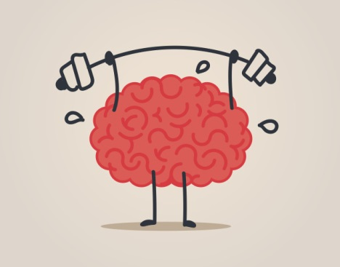
Na buntáistí The advantages
Cognitive
Communicative
Self-esteem
Academic
Cultural
Economic
“Will my child’s thinking be affected by being bilingual?”
The answer is “yes”, and probably for the better. The presence of two languages in the operating system of the brain is likely to produce a more richly-fed thinking engine. (Baker, 2000)
Notes:
Bigger, better, broader thinkers!
Better able to listen, to understand and to communicate
Proud of their achievements, with a sense of self and increased confidence in their abilities
Better results, higher achievement in standardised tests compared with their peers (Irish, Maths and English)
Broader appreciation of culture and difference, more tolerant, less racism
Better employment prospects

Slide 8
Tuilleadh eolais Further info
www.gaelscoileanna.ie
The Parents’ and Teachers’ Guide to Bilingualism, Colin Baker
www.multilingualparenting.com
Life as a Bilingual blog https://www.psychologytoday.com/blog/life-bilingual
Notes:
Research, news feed and Facebook highlights: NYT, BBC, TED Talks, etc.
Most of Baker’s book available on Google Books, also from local libraries
Parent and home-focused, practical advice and reassurance
Research-focused

